Slide 1
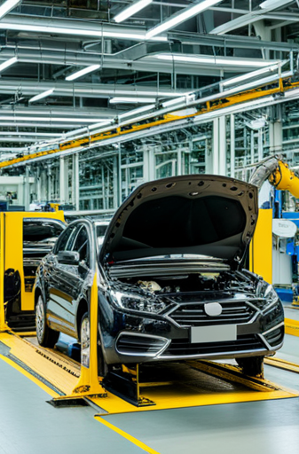
Analyzing the Impact of Car Features on Price and Profitability
BY
KARTHIK CV

Slide 2
CONTENTS:
PROJECT DESCRIPTION | A BRIEF OVERVIEW OF THE PROJECT, ITS OBJECTIVES
APPROACH | DESCRIBING MY PROJECT APPROACH AND EXECUTION, DETAILING THE TECHNIQUES AND TOOLS EMPLOYED IN THE PROCESS.
TECH-STACK USED | SPECIFY THE SOFTWARE USED
INSIGHTS | PROVIDING A SUMMARY OF THE INSIGHTS AND KNOWLEDGE ACQUIRED THROUGHOUT THE PROJECT.
RESULT | SOLVING THE QUESTIONS AND GETTING THE RESULTS

Slide 3
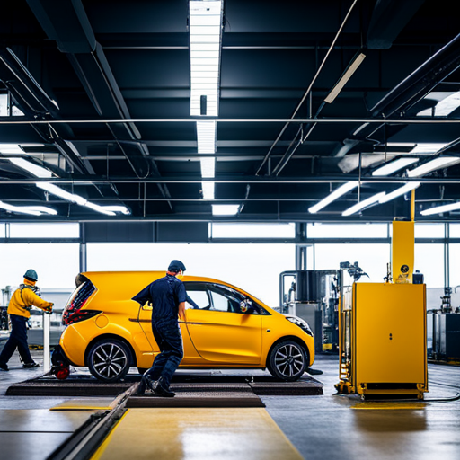
PROJECT DESCRIPTION:
The automotive industry has undergone significant transformation in recent years, driven by factors such as increasing consumer demand for fuel efficiency, environmental sustainability, and technological innovation. Car manufacturers are facing intensified competition and evolving consumer preferences, making it essential to leverage data-driven insights to optimize pricing and product development decisions. This project aims to address the crucial question: "How can a car manufacturer optimize pricing and product development decisions to maximize profitability while meeting consumer demand?“
Project Objectives The primary objectives of this project are as follows: a. Analyze the relationship between car features, market categories, and pricing. b. Identify the most popular features and market categories among consumers. c. Determine which features and market categories are the most profitable for the manufacturer. d. Develop a pricing strategy that balances consumer demand with profitability. e. Identify key product features to focus on in future product development efforts.

Slide 4
APPROACH:
FIRST DOWNLOAD THE EXCEL FILE.
OPEN THE DOWNLOADED EXCEL FILE.
THEN WHILE SEEING THE DATASET WE GET TO KNOW THERE ARE MANY MISSING VALUES IN BETWEEN.
USING COUNTIF FUNCTION WE GET TO KNOW HOW MANY COLUMNS ARE HAVING NULL VALUES.
USE EITHER AVERAGE OR MEDIAN TO FILL THE BLANK SPACES.

Slide 5
TECH-STACK USED:
MICROSOFT EXCEL
MICROSOFT POWERPOINT
GOOGLE DRIVE

Slide 6
INSIGHTS:
I HAD TO EXPLORE THE DATASET AND DERIEVE INSIGHTS BASED UPON THE QUESTIONS ASKED.
CREATED BAR & COLUMN CHART,COMBO CHART, BUBBLE CHART,SCATTER CAHRTS, TO SOLVE THE QUESTIONS.
HAD TO SORT,FILTER OUT THE COLUMNS SEPARATELY AND SOLVE THE ANSWERS.
Used Excel's functions like AVERAGE, COUNTIF,SUM,IF,ISBLANK
HAD TO CALCULATE REGRESSION ANALYSIS

Slide 7
TASKS:
01
04
02
05
03
How does the average price of a car vary across different manufacturers?
How does the popularity of a car model vary across different market categories?
What is the relationship between a car's engine power and its price?
What is the relationship between fuel efficiency and the number of cylinders in a car's engine?
Which car features are most important in determining a car's price?

Slide 8
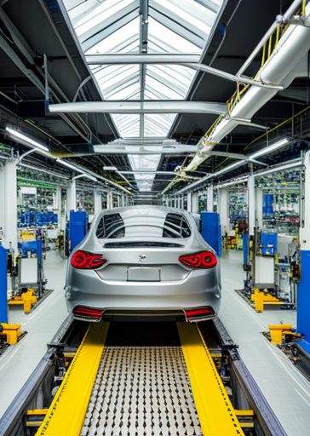
01
How does the popularity of a car model vary across different market categories?

Slide 9
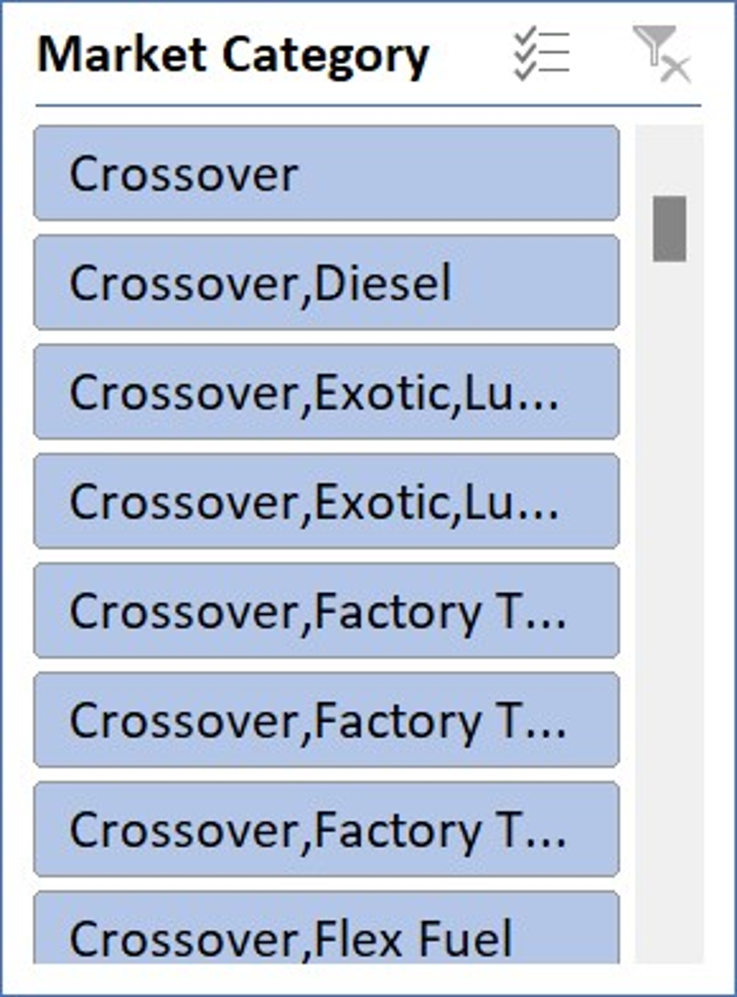
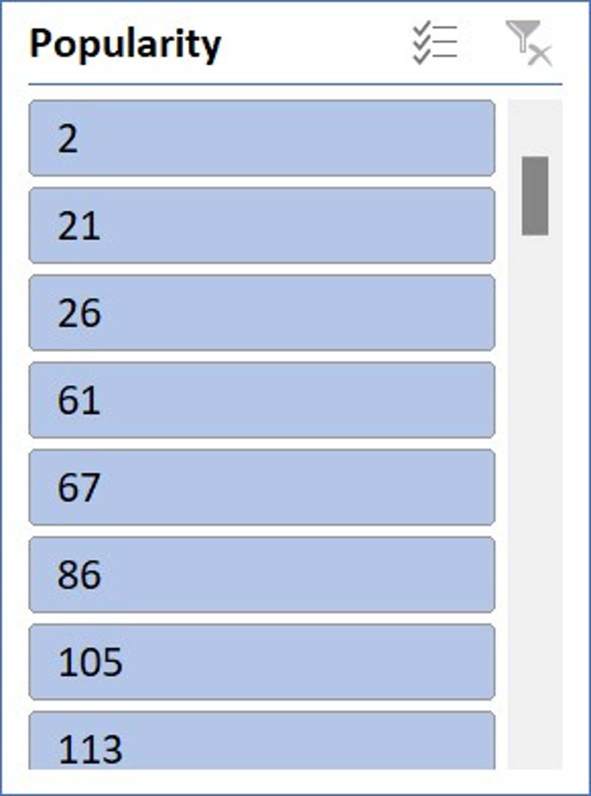
TOTAL SUM OF MRSP
Grand Total 483645697

Slide 10
02
What is the relationship between a car's engine power and its price?

Slide 13

03
Which car features are most important in determining a car's price?

Slide 14
SUMMARY OUTPUT
Regression Statistics
Multiple R | 0.673177781
R Square | 0.453168324
Adjusted R Square | 0.452984639
Standard Error | 44458.83581
Observations | 11913
ANOVA
 | df | SS | MS | F | Significance F
Regression | 4 | 1.95057E+13 | 4.87642E+12 | 2467.088434 | 0
Residual | 11908 | 2.35372E+13 | 1976588082
Total | 11912 | 4.30429E+13
 | Coefficients | Standard Error | t Stat | P-value | Lower 95% | Upper 95% | Lower 95.0% | Upper 95.0%
Intercept | -111999.0072 | 2904.826661 | -38.55617573 | 0 | -117692.9416 | -106305.0728 | -117692.9416 | -106305.0728
335 | 316.3558951 | 5.890130733 | 53.70948616 | 0 | 304.8102774 | 327.9015127 | 304.8102774 | 327.9015127
6 | 7026.055157 | 415.8216674 | 16.89679906 | 2.59035E-63 | 6210.976818 | 7841.133496 | 6210.976818 | 7841.133496
26 | 702.5737259 | 103.5911862 | 6.782176665 | 1.23978E-11 | 499.5180926 | 905.6293592 | 499.5180926 | 905.6293592
19 | 810.5213072 | 99.00524152 | 8.186650471 | 2.95879E-16 | 616.454874 | 1004.58774 | 616.454874 | 1004.58774

Slide 16

04
How does the average price of a car vary across different manufacturers?

Slide 18
TRANSMISSION TYPE | Average of MSRP
AUTOMATED_MANUAL | 99508.37061 |  | THE MOST SELLING IS AUTOMATED_MANUAL= 99508.37061
AUTOMATIC | 41110.33172
DIRECT_DRIVE | 47351.25
MANUAL | 26663.64429
UNKNOWN | 3040.736842
(blank)
Grand Total | 40594.73703

Slide 21

05
What is the relationship between fuel efficiency and the number of cylinders in a car's engine?

Slide 22
CORRELATION | -0.614541417
 | a negative coefficient suggests a negative relationship (more cylinders generally lead to lower highway MPG).

Slide 23
Row Labels | Average of Engine HP | Average of highway MPG | Average of MSRP
Acura | 244.797619 | 28.11111111 | 34887.5873
Alfa Romeo | 237 | 34 | 61600
Aston Martin | 484.3225806 | 18.89247312 | 197910.3763
Audi | 277.695122 | 28.82317073 | 53452.1128
Bentley | 533.8513514 | 18.90540541 | 247169.3243
BMW | 326.9071856 | 29.24550898 | 61546.76347
Bugatti | 1001 | 14 | 1757223.667
Buick | 219.244898 | 26.94897959 | 28206.61224
Cadillac | 332.3098237 | 25.23677582 | 56231.31738
Chevrolet | 245.6527159 | 25.81567231 | 28350.38557
Chrysler | 229.1390374 | 26.36898396 | 26722.96257
Dodge | 244.4153355 | 22.34504792 | 22390.05911
Ferrari | 511.9565217 | 15.72463768 | 238218.8406
FIAT | 136.6129032 | 37.33870968 | 22670.24194
Ford | 239.5107832 | 24.00681044 | 27399.26674
Genesis | 347.3333333 | 25.33333333 | 46616.66667
GMC | 259.8446602 | 21.4038835 | 30493.29903
Honda | 194.8775056 | 32.57461024 | 26674.34076
HUMMER | 261.2352941 | 17.29411765 | 36464.41176
Hyundai | 201.9174917 | 30.39273927 | 24597.0363
Infiniti | 310.0666667 | 24.77878788 | 42394.21212
Kia | 202.3506494 | 30.65367965 | 25310.17316
Lamborghini | 614.0769231 | 18.01923077 | 331567.3077
Land Rover | 322.0979021 | 22.12587413 | 67823.21678
Lexus | 277.4158416 | 25.87623762 | 47549.06931
Lincoln | 271.0121951 | 24.48780488 | 42839.82927
Lotus | 275.9655172 | 26.55172414 | 69188.27586
Maserati | 420.7931034 | 20.29310345 | 114207.7069
Maybach | 590.5 | 16 | 546221.875
Mazda | 171.9929078 | 27.85106383 | 20039.38298
McLaren | 610.4 | 22.2 | 239805
Mercedes-Benz | 349.1898017 | 24.83002833 | 71476.22946
Mitsubishi | 172.6150235 | 27.54460094 | 21240.53521
Nissan | 235.6218638 | 27.79928315 | 28583.4319
Oldsmobile | 177.4666667 | 26.23333333 | 11542.54
Plymouth | 131.5609756 | 27.96341463 | 3122.902439
Pontiac | 190.2956989 | 27.06989247 | 19321.54839
Porsche | 392.7941176 | 25.36764706 | 101622.3971
Rolls-Royce | 487.5483871 | 19.12903226 | 351130.6452
Saab | 220.5225225 | 26.35135135 | 27413.5045
Scion | 154.4333333 | 32.3 | 19932.5
Spyker | 400 | 18 | 213323.3333
Subaru | 197.3085938 | 28.68359375 | 24827.50391
Suzuki | 160.2877493 | 26.03418803 | 17907.20798
Tesla | 0 | 98.94444444 | 85255.55556
Toyota | 235.5147453 | 26.45308311 | 29030.01609
Volkswagen | 189.7577256 | 32.12855377 | 28102.38072
Volvo | 230.9715302 | 27.20284698 | 28541.16014
(blank)
Grand Total | 247.9417492 | 26.63748531 | 40594.73703

Slide 24
Row Labels | Average of Engine HP | Average of city mpg | Average of MSRP
Acura | 244.797619 | 19.94047619 | 34887.5873
Alfa Romeo | 237 | 24 | 61600
Aston Martin | 484.3225806 | 12.52688172 | 197910.3763
Audi | 277.695122 | 19.58536585 | 53452.1128
Bentley | 533.8513514 | 11.55405405 | 247169.3243
BMW | 326.9071856 | 20.73952096 | 61546.76347
Bugatti | 1001 | 8 | 1757223.667
Buick | 219.244898 | 18.70408163 | 28206.61224
Cadillac | 332.3098237 | 17.35516373 | 56231.31738
Chevrolet | 245.6527159 | 19.02137133 | 28350.38557
Chrysler | 229.1390374 | 17.75935829 | 26722.96257
Dodge | 244.4153355 | 16.06549521 | 22390.05911
Ferrari | 511.9565217 | 10.56521739 | 238218.8406
FIAT | 136.6129032 | 30.64516129 | 22670.24194
Ford | 239.5107832 | 17.96027242 | 27399.26674
Genesis | 347.3333333 | 16.33333333 | 46616.66667
GMC | 259.8446602 | 15.81359223 | 30493.29903
Honda | 194.8775056 | 25.44320713 | 26674.34076
HUMMER | 261.2352941 | 13.52941176 | 36464.41176
Hyundai | 201.9174917 | 22.34323432 | 24597.0363
Infiniti | 310.0666667 | 17.82727273 | 42394.21212
Kia | 202.3506494 | 23.84848485 | 25310.17316
Lamborghini | 614.0769231 | 11.51923077 | 331567.3077
Land Rover | 322.0979021 | 16.23076923 | 67823.21678
Lexus | 277.4158416 | 20.31188119 | 47549.06931
Lincoln | 271.0121951 | 17.8902439 | 42839.82927
Lotus | 275.9655172 | 18.75862069 | 69188.27586
Maserati | 420.7931034 | 13.32758621 | 114207.7069
Maybach | 590.5 | 10 | 546221.875
Mazda | 171.9929078 | 21.24586288 | 20039.38298
McLaren | 610.4 | 15.6 | 239805
Mercedes-Benz | 349.1898017 | 18.18130312 | 71476.22946
Mitsubishi | 172.6150235 | 21.91079812 | 21240.53521
Nissan | 235.6218638 | 21.87455197 | 28583.4319
Oldsmobile | 177.4666667 | 17.60666667 | 11542.54
Plymouth | 131.5609756 | 20.79268293 | 3122.902439
Pontiac | 190.2956989 | 18.6827957 | 19321.54839
Porsche | 392.7941176 | 17.47058824 | 101622.3971
Rolls-Royce | 487.5483871 | 11.83870968 | 351130.6452
Saab | 220.5225225 | 17.76576577 | 27413.5045
Scion | 154.4333333 | 25.31666667 | 19932.5
Spyker | 400 | 13 | 213323.3333
Subaru | 197.3085938 | 21.7890625 | 24827.50391
Suzuki | 160.2877493 | 19.91452991 | 17907.20798
Tesla | 0 | 94.11111111 | 85255.55556
Toyota | 235.5147453 | 21.55495979 | 29030.01609
Volkswagen | 189.7577256 | 23.58096415 | 28102.38072
Volvo | 230.9715302 | 19.58362989 | 28541.16014
(blank)
Grand Total | 247.9417492 | 19.73325499 | 40594.73703

Slide 25
EXCEL LINK:
https://docs.google.com/spreadsheets/d/1ELdxgKfzC6SzIX4KdR5niekg7j2fNNva/edit?usp=sharing&ouid=113218835467978713928&rtpof=true&sd=true

Slide 26
THANK YOU

